Slide 1
RTB(Cycle 10)
(Advanced Microservice)
Employee:
Aayushi Bansal
IIPL-6802
Software Engineer
Evaluator:
Pushpendra Garg

Slide 2
Objective
To be able to understand various Microservice patterns (Java) with clear concept of Spring Boot, Security, Actuator and able to differentiate between monolithic Vs. Micro services architecture
Topics Covered
Microservices
Spring Boot
Spring Security
Data and Transaction Management
API Gateway
Service Discovery
Circuit Breaker
CICD
Monitoring Using Actuator
Apache Kafka
Zipkin
Unit Testing

Slide 3
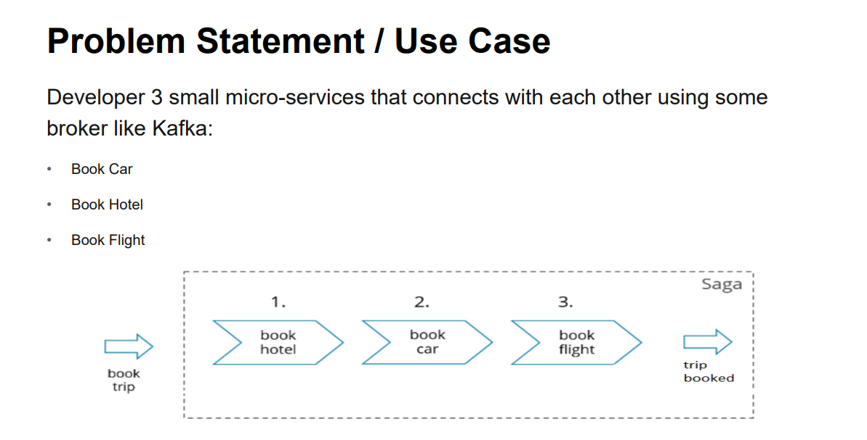
Problem Statement/Use Case

Slide 4
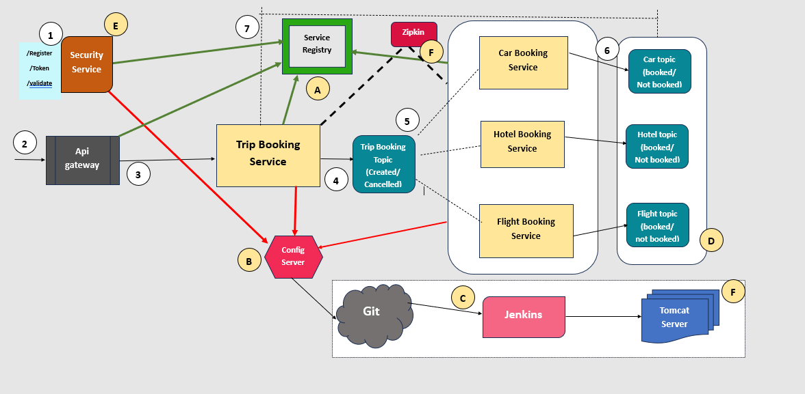
Solution

Slide 5
Description
A brief description of components A-F
A-Service Registry :This is the microservice where all the service register themselves so that they can become a part of Service discovery.
B-Config Server -This microservice is connected to the Git Server from where it fetches all common configurations used across all the services and other services fetches them from here.
C-Jenkins -This is the build tool which is used for CI/CD.
D-Kafka Topics -These are the kafka broker topics which help in asynchronous communication among services.
E-Security Service -This is the spring security service which is used for authentication and authorization
F-CICD -Continuous Integration and continuous deployment. Project is taken from the GitHub and then built in Jenkins and the deployed to tomcat server.

Slide 6
Description
A brief description of steps (1-9)
1.Client reaches out to the security service to register itself and gets a token.
2.Then client will hit the Api gateway using the token.
3. the token will be validated by the Api gateway. If the user is authenticated he is able to fetch the trip boking endpoint along with his request body in which he specifies his requirements.
4. The trip booking service on getting a trip book request will put a trip created message onto the Kafka broker
5.The messages in the trip booking topic will be read by the subscriber services which are the car service, flight service, hotel service.

Slide 7
Description
6.The hotel, car and flight services will perform the required steps and will put status onto the respective Kafka topics mentioning whether the booking is done or not.
7.The trip booking service which has subscribed to all the topics will get a message and will process further. If any of the service gives a status ,message as not booked the trip booking service will cancel the trip booking and put a trip cancelled status onto the tripbookingtopic which will be read by the other 3 services and based on the tripBookingId they will roll back the transactions they have done. But if all the services return a trip booked status then the trip will be booked and status will be updated in the trip booking database.

Slide 8
Thank you.

